Slide 1

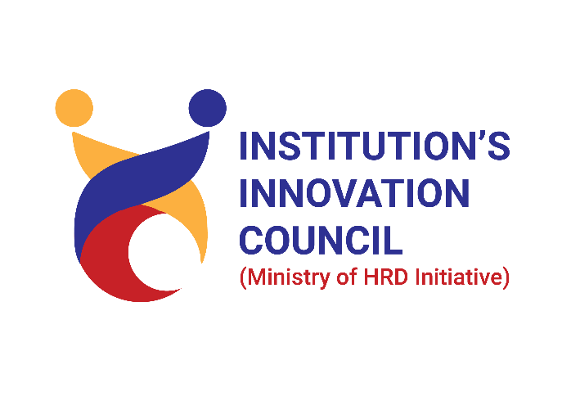
GE19621 – PROFESSIONAL READINESS FOR INNOVATION, EMPLOYABILITY AND ENTREPRENEURSHIP
DEPARTMENT OF COMPUTER SCIENCE AND ENGINEERING
Interactive AI Chatbot for Mental Illness Treatment
Team Member 1 : Madhumita P
Team Member 2 : Manjunathan S
Team Member 3 : Mohammad Sajjad
TEAM NAME: MindTech Innovators
MENTOR : Dr.P.Shanmugam

Slide 2
ABSTRACT
This project focuses on developing a chat bot at the intersection of mental illness and technology, drawing from cognitive behavioral therapy principles and natural language processing techniques. It provides a confidential space for users to express emotions, receive psychoeducation, and access coping strategies tailored to their needs. The chat bot aims to destigmatize mental illness, facilitate early intervention, and promote selfcare practices. Integrating expertise from psychology, computer science, and user experience design, ethical considerations are carefully addressed. User feedback and testing ensure effectiveness and satisfaction. The goal is to contribute to research on technology-assisted mental health interventions and provide a scalable solution for supporting individuals in an accessible and empathetic manner, fostering resilience, improving well-being, and promoting inclusivity in mental health care.

Slide 3
TECHNOLOGY USED
In developing the AI mental chatbot project, a combination of advanced technologies and tools was employed to ensure a robust, user-friendly, and effective platform. Visual Studio served as the integrated development environment (IDE), providing a comprehensive suite for coding, debugging, and project management. The frontend structure and design of the chatbot interface were created using HTML for the content structure and CSS for styling, ensuring a visually appealing and responsive user experience. On the backend, Node.js was utilized to handle server-side operations, enabling real-time interaction capabilities and efficient handling of multiple user requests. Additionally, Google Studio was leveraged for data visualization and analysis, offering insights into user interactions and chatbot performance. To integrate various Google services, the project utilized a Google API key, facilitating access to powerful APIs that enhance the chatbot's functionality. This combination of technologies ensures the AI mental chatbot is not only functional and accessible but also scalable and secure, providing users with reliable mental health support.

Slide 4
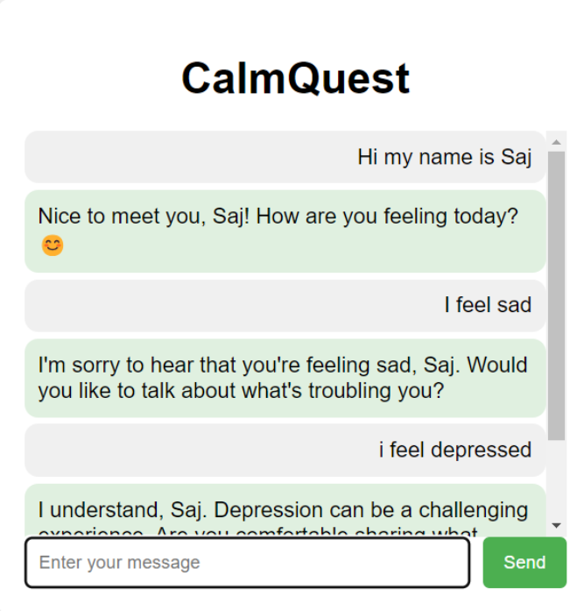
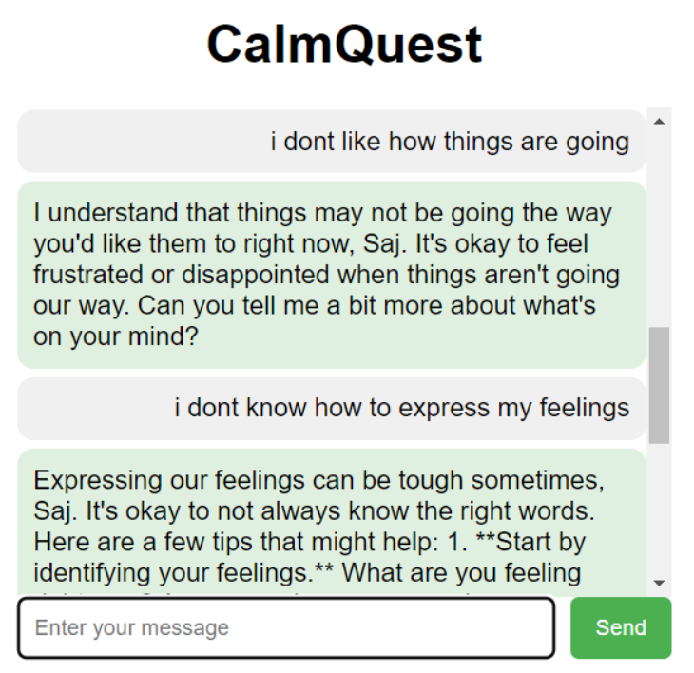
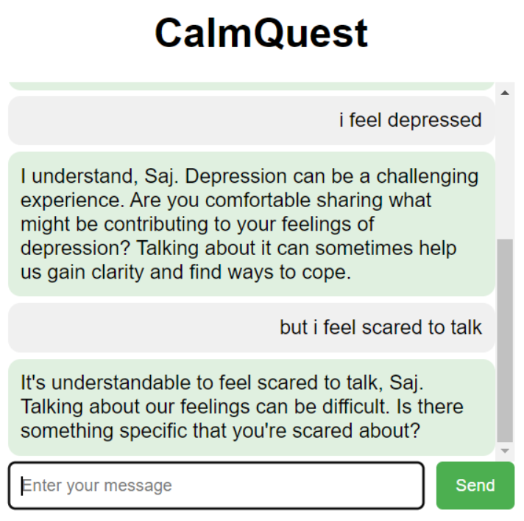
PROPOSED SOLUTION

Slide 5
CONCLUSION
The AI mental chatbot project represents a groundbreaking advancement in mental health care, offering a novel solution that leverages artificial intelligence to provide immediate, personalized support around the clock. By addressing critical issues of accessibility and stigma, the chatbot can significantly enhance the availability of mental health resources, particularly for underserved populations and individuals hesitant to seek traditional therapy. This innovative approach introduces a new, engaging, and effective method of delivering care, integrating sophisticated AI with evidence-based therapeutic techniques to ensure users receive relevant and empathetic support. By bridging gaps in current mental health services, this project paves the way for a more inclusive and responsive mental health support system, ultimately contributing to better mental health outcomes and overall well-being.

Slide 6
SOCIAL RELEVANCE
Increased Accessibility to Mental Health Care:
AI mental chatbots provide round-the-clock access to mental health support, significantly increasing accessibility for individuals who face barriers such as geographical limitations, financial constraints, or long wait times for traditional therapy. These chatbots offer immediate responses and interventions, which is crucial for individuals experiencing acute mental health crises or needing instant support without the delays associated with scheduling appointments
2.Reduction of Stigma:
Interacting with an AI chatbot can reduce the stigma associated with seeking mental health treatment, as many individuals may feel more comfortable disclosing their issues to a non- judgmental, anonymous entity rather than a human therapist. By providing a confidential and stigma-free environment, AI chatbots encourage more people to seek help for their mental health issues, potentially leading to earlier intervention and better outcomes.
3.Support for Under-Resourced Populations:
AI mental chatbots can play a critical role in regions with limited access to mental health professionals, offering scalable and cost-effective support to underserved populations. This is particularly beneficial in low-income communities and developing countries where mental health resources are scarce. These tools also supplement traditional mental health services by providing ongoing support between therapy sessions, helping to maintain continuity of care and potentially improving treatment outcomes.

Slide 7
REFERENCES
https://www.w3schools.com/nodejs/
https://www.codecademy.com/catalog/language/html-css
https://developers.google.com/learn/pathways/solution-ai-gemini-101
https://woebothealth.com/
https://www.wysa.com/
https://code.visualstudio.com/docs/introvideos/basics

Slide 8
THANK YOU

